Slide 1

21AIE113
Introduction to Electronics
Under the guidance of:
Ms. Sudha Yadav

Slide 2
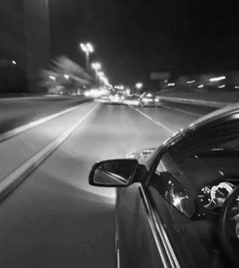
Smart Accident Detection And Alert System

Slide 3
Batch : E4 Team members:
M RAMYA SREE (BL.EN.U4AIE21072)
METTU SIDDHARTHA (BL.EN.U4AIE21080)
POLI VAMSI VARDHAN REDDY (BL.EN.U4AIE21101)

Slide 4
Index
Introduction
Problems
Current systems
System Features
User interface
Components
Block diagram
Circuit
Reference

Slide 5

Introduction
This device is for the automation of accident detection and notifying the hospitals, police stations and relatives about the accident data.
The proposed device is for accident notification system (A.N.S). This product will be used in vehicles to get the data of accident and further notifying police station and hospitals.
Goal: It will reduce the no of deaths in accident cases and will help to track data of car .Including, will help to solve various cases of road accident and will able to find the culprit.

Slide 6
Problems
1. No notification system in car to notify about accident.
2. Car tracking not available.
3. No Emergency system to notify about injured.
4. No system to notify damage percentage of car.
5. No system to find lost and stolen cars.

Slide 7

CURRENT systems:
At present criteria, we cannot detect where the accident has occurred and hence no information related to it, leading to the death of an individual.
Some of the systems can detect accidents and send location to hospitals / ambulance thorough your phone location only .
Most of the accident detection systems rely on the high speed of the vehicle extracted from the smart phone GPS receiver .
In some system only the buzzer will raise during any accidents, and hence the patrol cannot exactly locate the accident spot.

Slide 8


Our IDEA :
GPS tracking system to be enabled in car.
Instant notification system to be enabled to notify hospital in alarming case.
Sound notification in hospital and message notification with location.
In case of lost car GPS will track car and detect the location.
Recorded data of car movement will be maintained.
GPS system to be attached with car no. and owner details.
After accident sound alarm will be played and then will be cached by sound sensor which further will send notification.
Notification will be sent with car number and owner details.
After searching for car details will get actual location of cars and can contact owner.

Slide 9

SOLUTION :
Instant Notification to Hospital in case of accident.
Instant medical support to the injured person.
Instant information to the driver family.
Sound alarm information to locals present in the area.
Information regarding the car movement and history of car movement.
Information regarding the vehicle movement can help in solving many mysteries of various crimes.
Instant notification to police station and hence easy finding the reason of accident

Slide 10
SYSTEM FEATURES:
Description and priority:
The accident notification System notifies or informs about the accident spot , time to the nearby hospital , police station and family members .Of course, this project has very high priority in order because will save life in road accident .
Stimulus/Response Sequences:
Accident will be detected by accelerometer.
Engine stops.
Alarm starts.
Gsm model activates and send notification.

Slide 11
EXTERNAL INTERFACE REQUIREMENT
User Interface :
Car Driver with car
Hardware interface :
Power supply with processor
ARDUINO UNO
Accelerometer with processor
GSM with Processor as input and output.
GPS with processor as input and output and device tracker .
Display unit for output from processor.
Software Interface :
Attaching and integrating message system with Display .
Calling Api of google map and converting longitude and longitude to location.
Communications Interfaces
The device uses latest messaging apps ex. messenger
Location sent can be used by any browser.

Slide 12
USER INTERFACE
System can track geographical information automatically and sends an alert SMS regarding accident.
Arduino system sends the alert message through the GSM MODULE to police , hospital , relatives. So the they can immediately trace the location through the GPS MODEM, after receiving the information. Then after conforming the location necessary action will be taken.
If the person meets with a small accident or if there is no serious threat to anyone`s life, then the alert message will be terminated.
If there is any damage to the car then the circuit attached with airbag inflator starts working , when gets excess of nitrogen pumps and on the sensor which further send the notification.

Slide 13
Required components
Arduino uno R3
Bread boards
Resistors
Led
Piezo buzzer
Sparkfun MMA7361 Breakout
16x2 LCD display
Push button
Temperature sensor

Slide 14
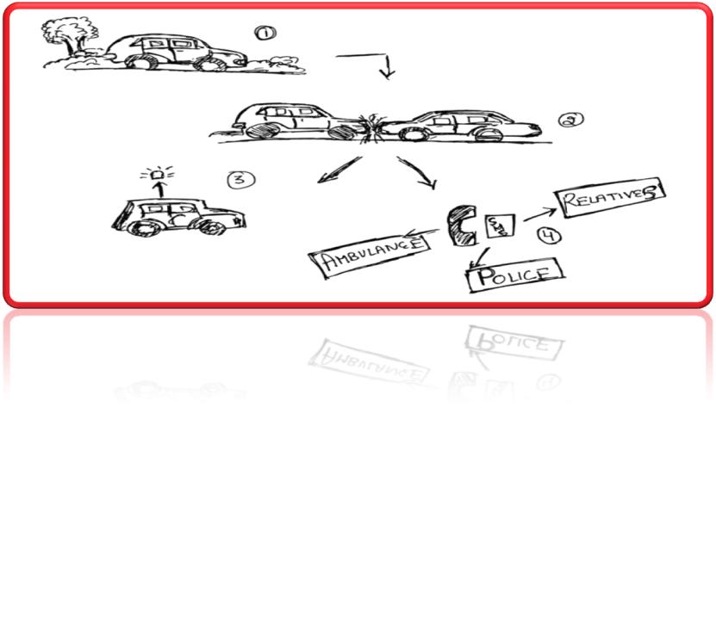
Rough sketch
When the car is moving
If suddenly any accident takes place anywhere .
This helps in notifying about the accident by its sound system .
Then our accidential and informer system will notify to person’s family / relatives , to police & to ambulance or nearby hospital

Slide 15
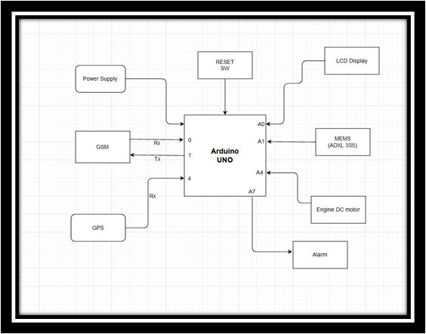
Block diagram

Slide 16
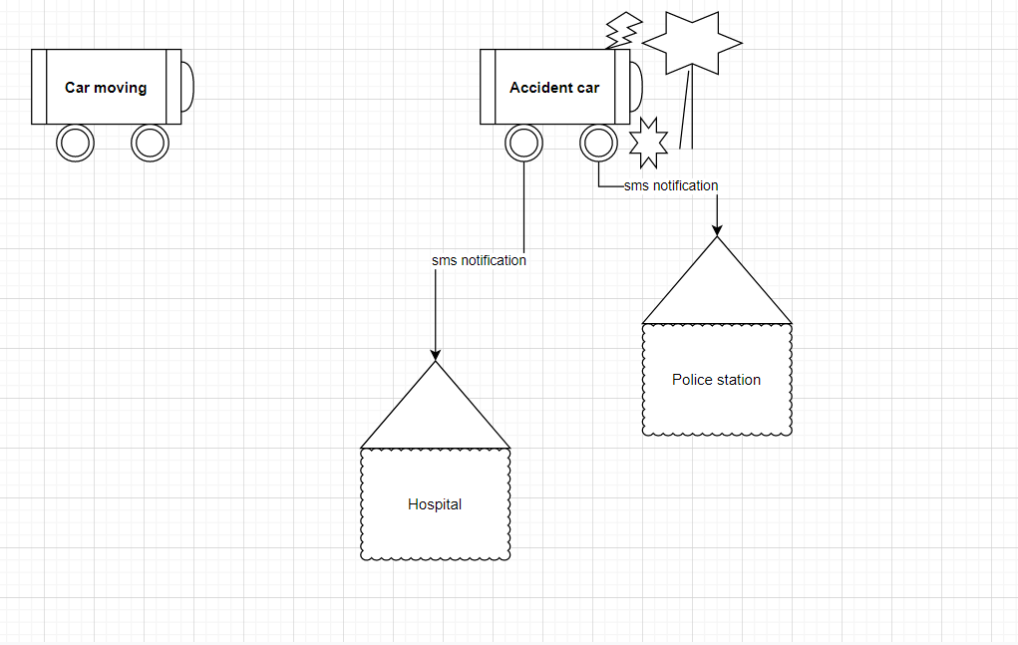
Product Features

Slide 17
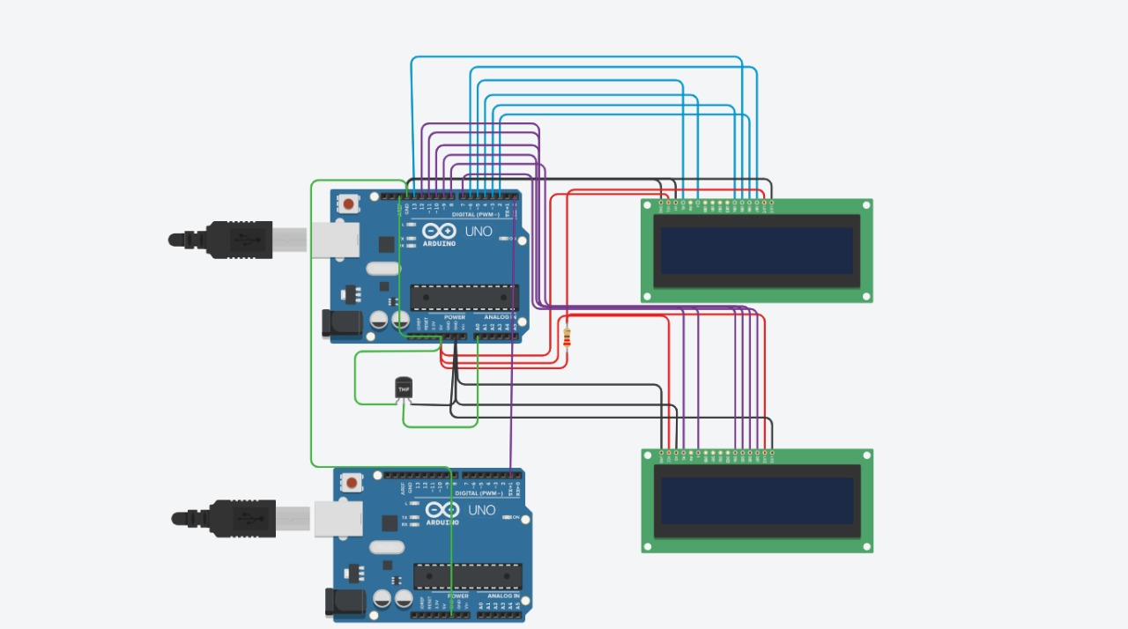

CIRCUIT DIAGRAM
GLOBAL POSITIONING SYSTEM (GPS) CIRCUIT

Slide 18
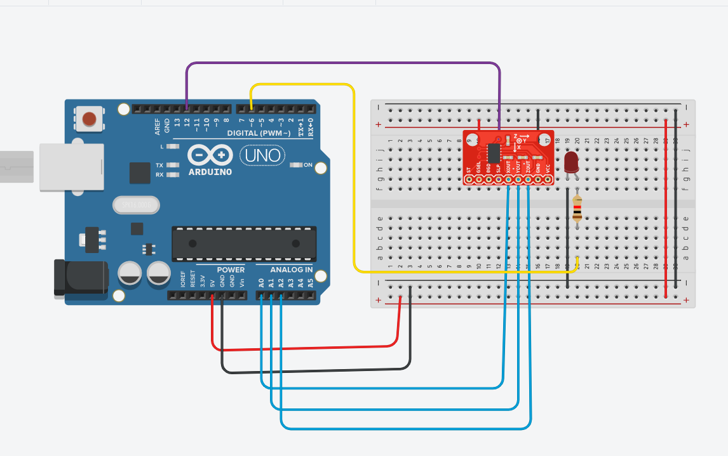
CIRCUIT DIAGRAM
ACCELERO METER USING ADXL-335

Slide 19
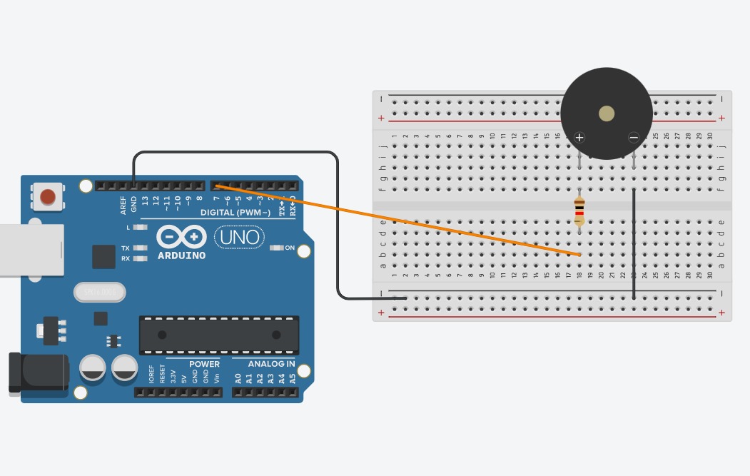
CIRCUIT DIAGRAM
BUZZER ALARM DETECTION

Slide 20
Reference
https://ieeexplore.ieee.org/document/9582163
https://ieeexplore.ieee.org/stamp/stamp.jsp?tp=&arnumber=9582163

Slide 21
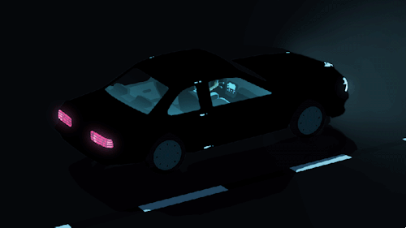
~THANK YOU~

